Slide 1
Machine Learning for the Greater Good

Slide 2
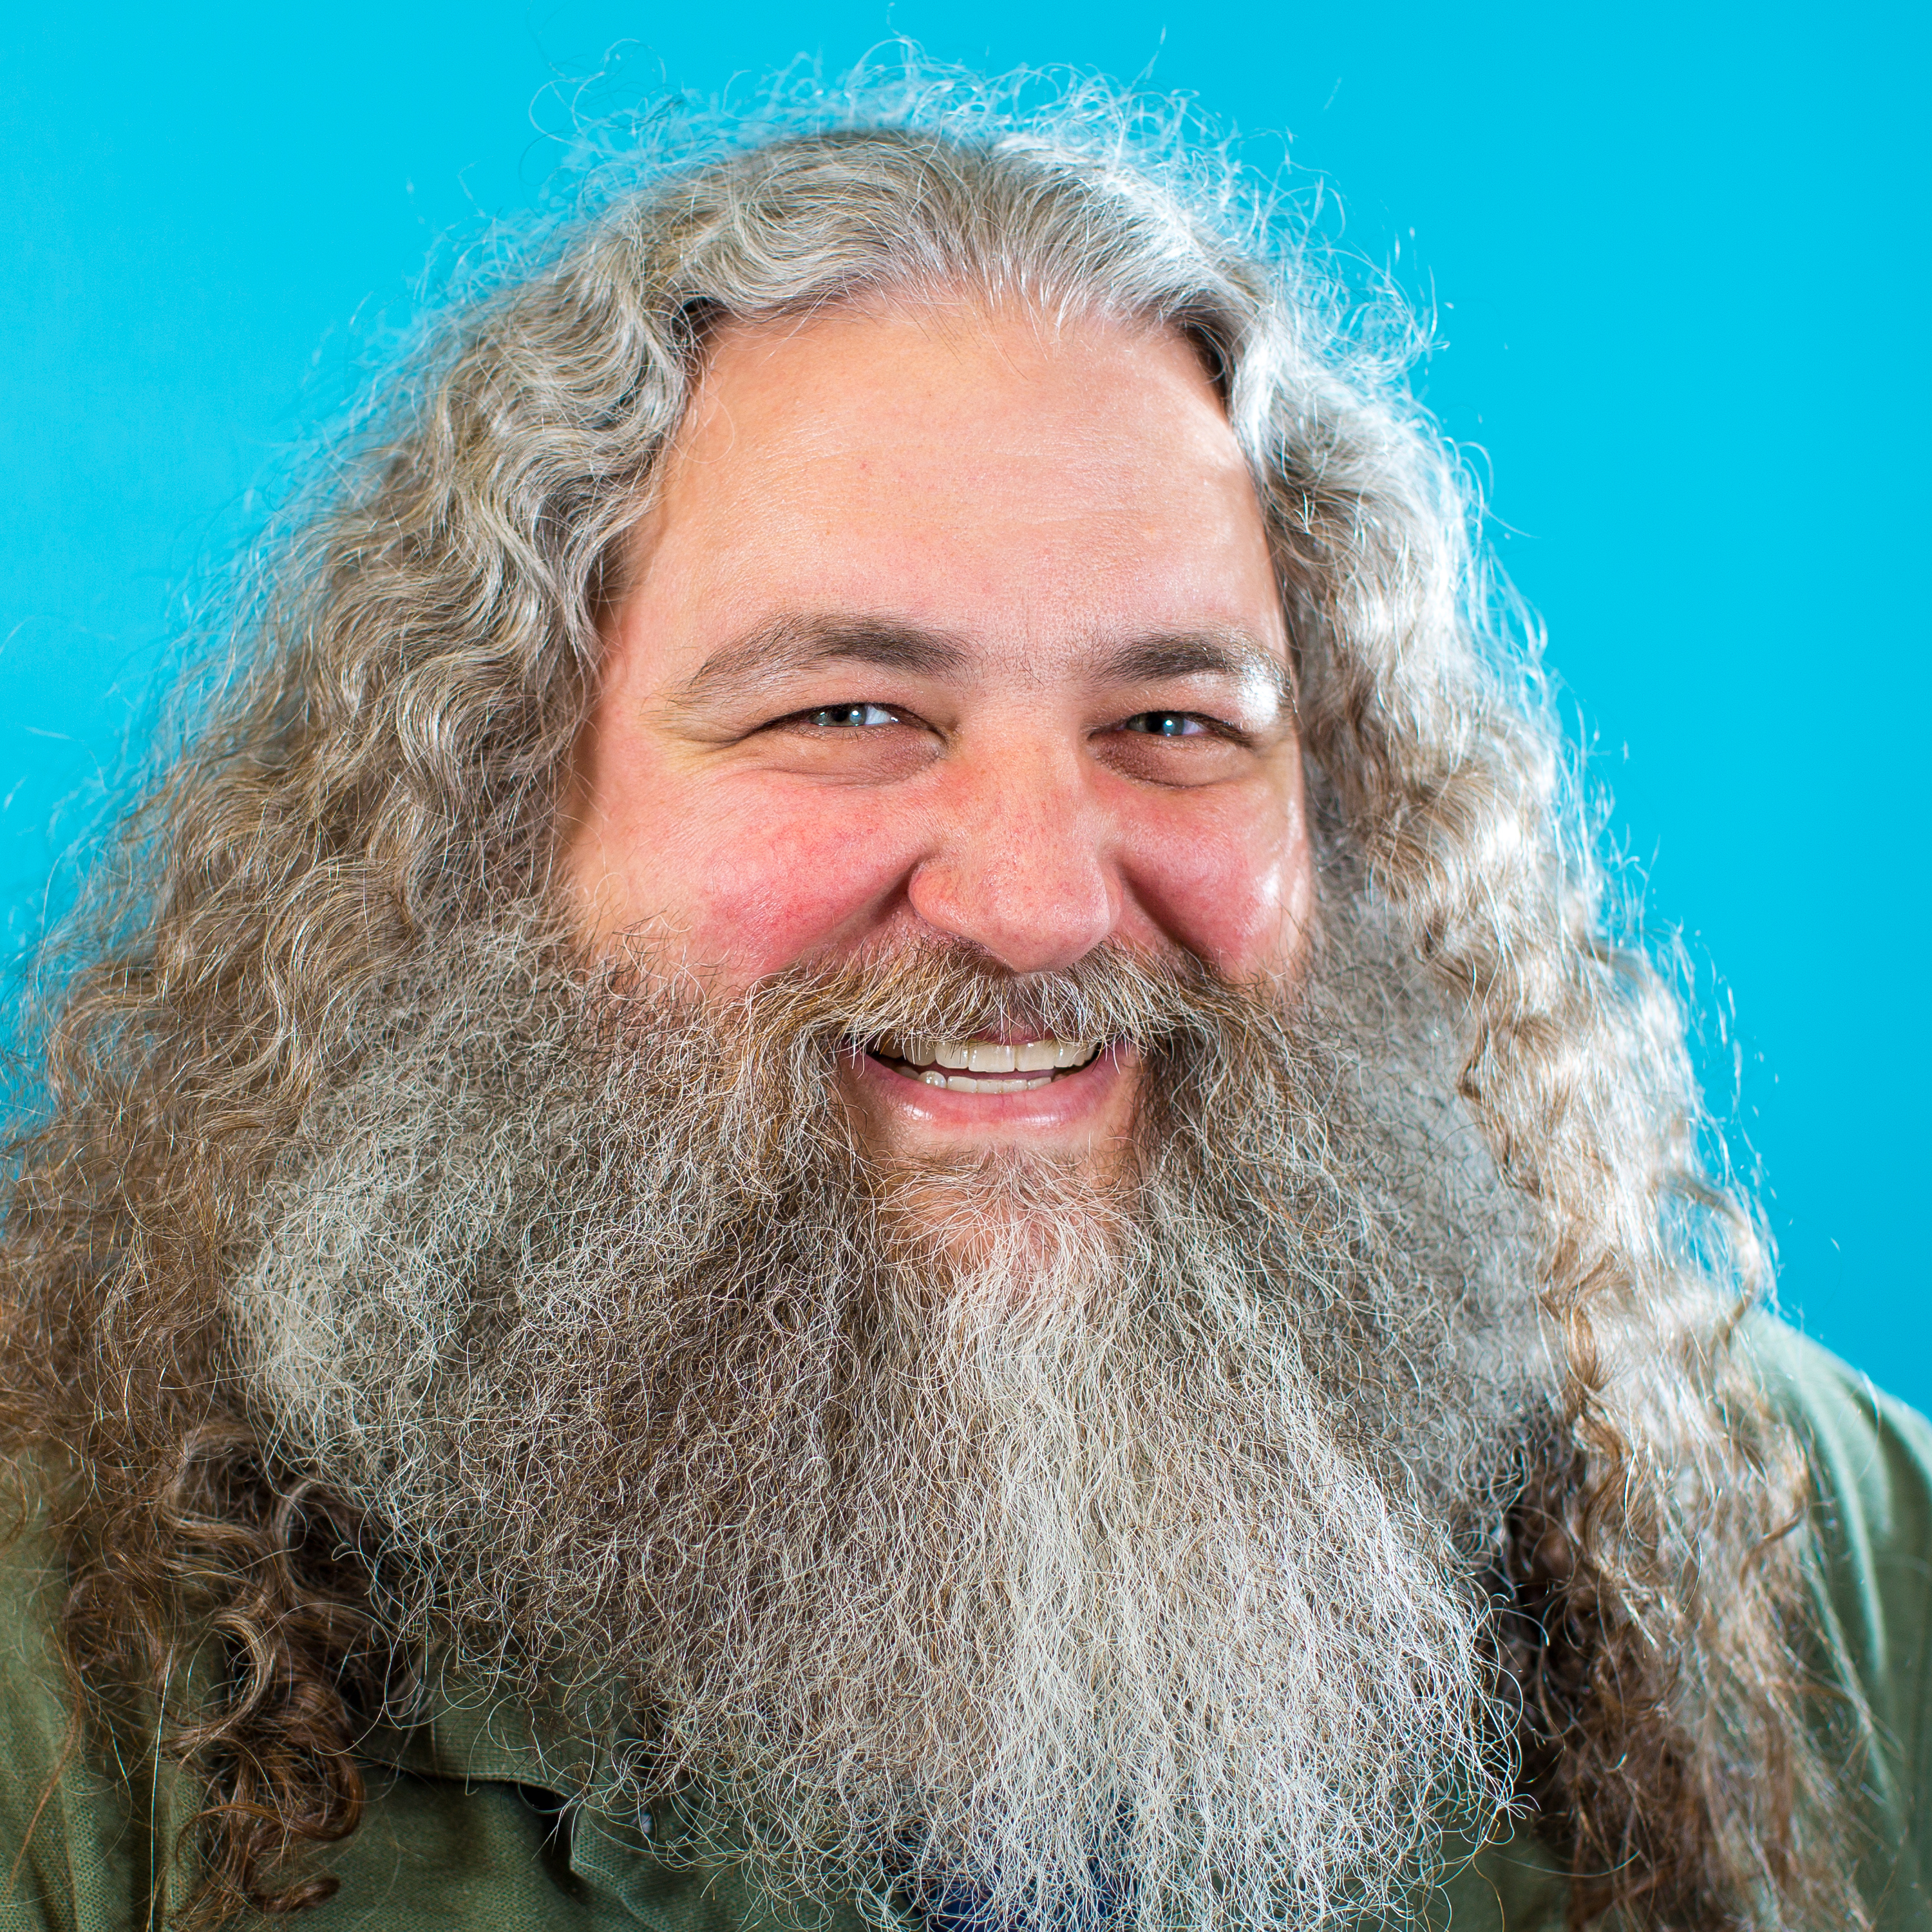
Who is this Guy?
Guy Royse
Developer Evangelist
Nexosis
guy@nexosis.com
@guyroyse
Notes:
Evangelist, intro thyself.

Slide 3
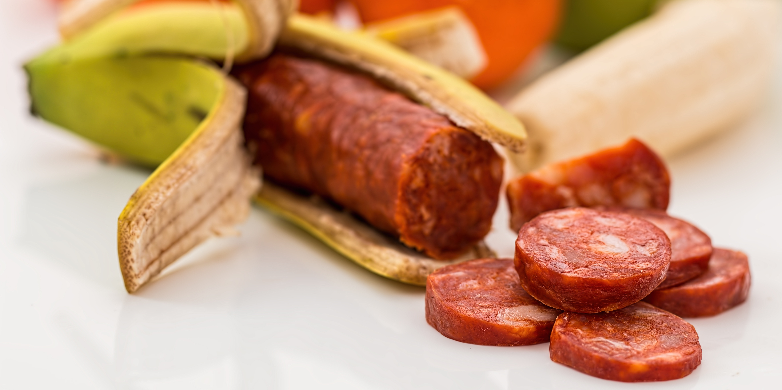

Slide 4


Slide 5
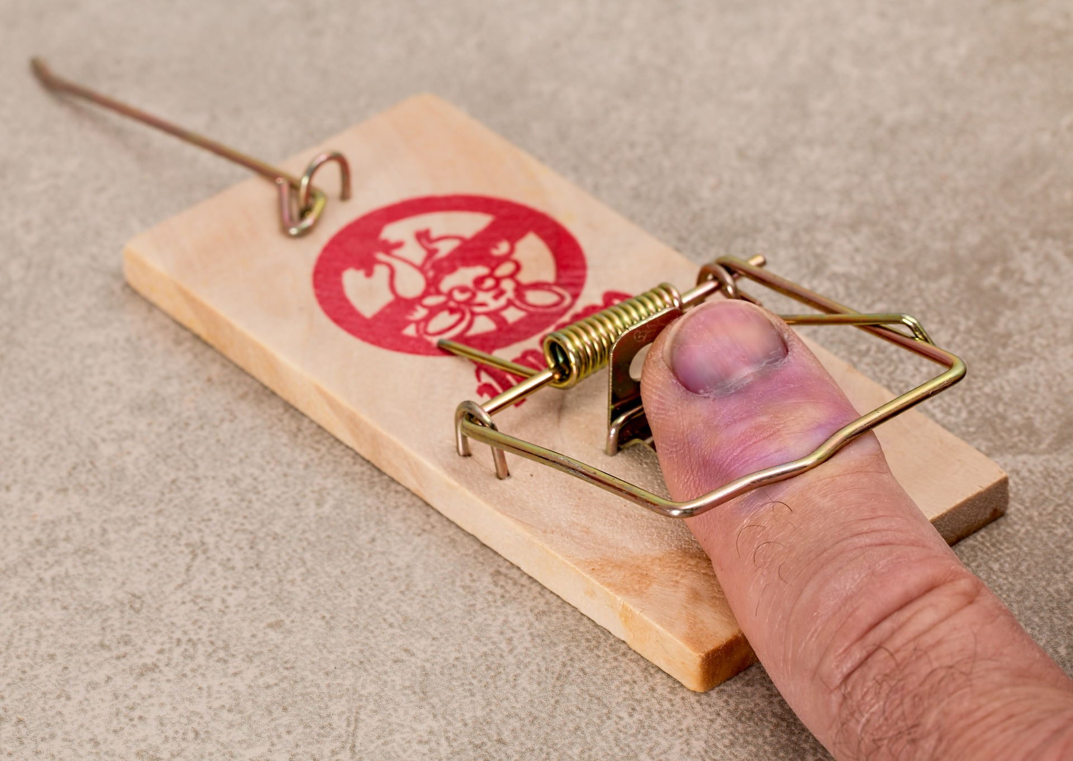
You’re Dumb
“Half of being smart is knowing what you are dumb about.”
Solomon Short
Notes:
Share story about shut-ing down a warehouse and misspelling Virginia.

Slide 6
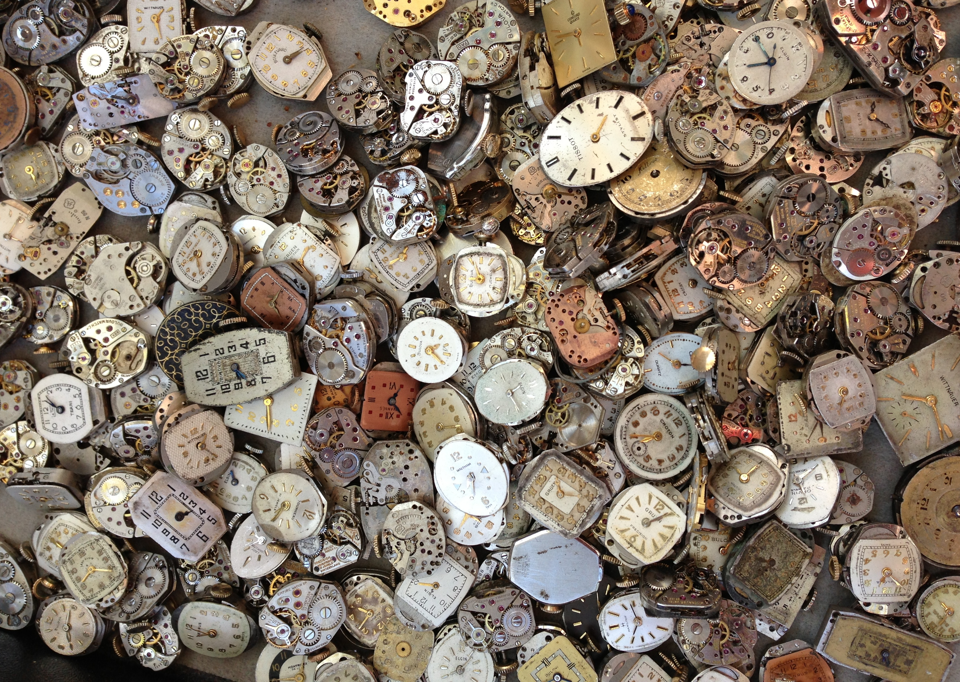
Dates Are Hard
“The day after tomorrow is the third day of the rest of your life.”
George
Carlin
Notes:
Broken dates. Tell story from Cardinal Solutions birth date calculations

Slide 7


Play With Your Code
“I play the harmonica. The only was I can play is if I get in my car going really fast, and stick it out the window.”
Steven
Wright
Notes:
Talks about some silly things I’ve made.

Slide 8
Embrace Change
“Just when I discovered the meaning of life, they changed it.”
George
Carlin
Notes:
There is not one true way to do things. Everything is always a trade-off. If it wasn’t, that’d just be how they do it. Client, Internet, Mobile, IoT, Machine Learning

Slide 9
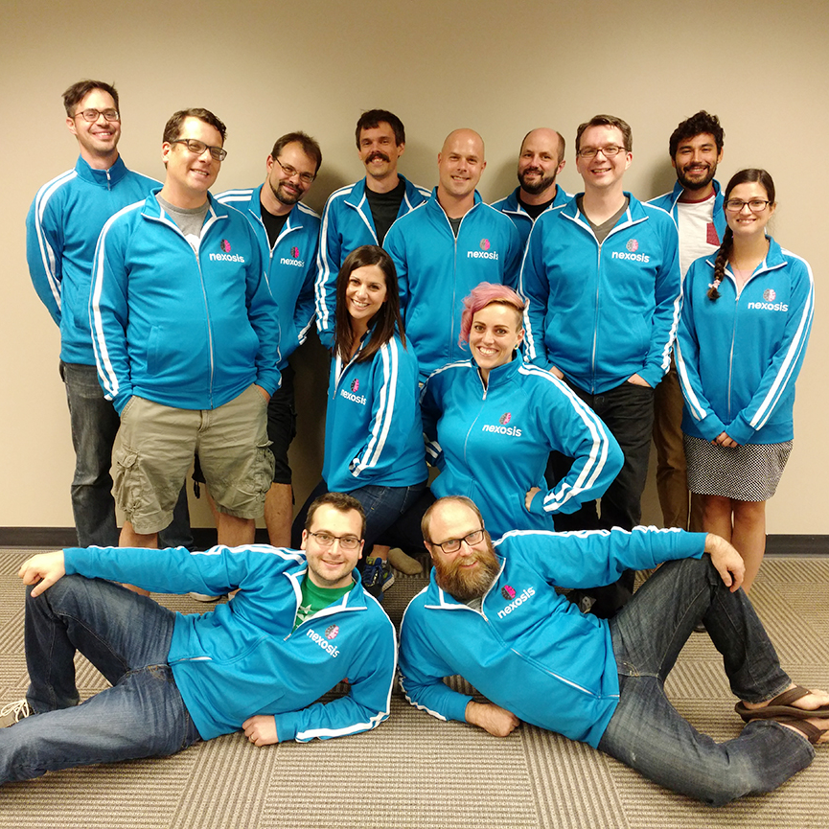
Who is this Company?
Nexosis is a company of developers focused on providing easy access to machine learning.
Notes:
Our API offers forecasting, impact analysis, and anomaly detection by analyzing your data, along with public and private data sets. We empower developers, data scientists, and business analysts to make smarter decisions, faster.

Slide 10
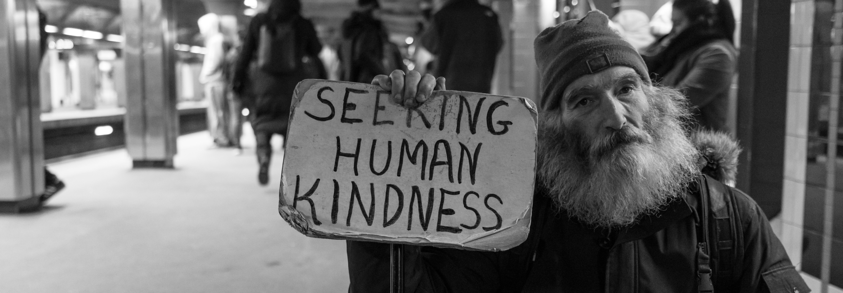
Challenge
Build an application that uses our API to make the world a better place.

Slide 11
Rules
Any type of application will be considered: mobile, IoT, desktop, and web applications are all welcome.
Applications must be built from scratch. While you are free to use as many open-source libraries as you like, please do not come to the hackathon with a pre-made solution.
Applications must use the Nexosis API to be considered.
In the event of a tie, the judges will pick the winner based on which idea they think will have the most impactful.
Prizes will be awarded after the hackathon so make sure your contact information is correct.

Slide 12

Prize
Win $1000 toward a select charity and trophies for your entire team!

Slide 13
Charities
Against Malaria Foundation
Alzheimer's Association
American Cancer Society
American Diabetes Association
American Heart Association
American Kidney Fund
American Red Cross
ASPCA
AmeriCares
Amnesty International
Autism Speaks
Bill & Melinda Gates Foundation
Boy Scouts of America
Boys & Girls Clubs of America
Children International
Civitan International
Creative Commons
Cystic Fibrosis Foundation
Direct Relief
Doctors Without Borders
Electronic Frontier Foundation
Girl Scouts of the USA
GiveWell
Habitat for Humanity International
Helen Keller International
Humane Society of the United States
JDRF
Leukemia & Lymphoma Society
Make-A-Wish Foundation of America
Malala Fund
MAP International
March of Dimes Foundation
Marine Toys for Tots Foundation
Mayo Clinic
National Multiple Sclerosis Society
National Public Radio
Natural Resources Defense Council
Paralyzed Veterans of America
Public Broadcasting Service
Ronald McDonald House Charities
Salvation Army
Shriners Hospitals for Children
Smithsonian Institution
St. Jude Children's Research Hospital
The Rotary Foundation
United Nations Foundation
United Negro College Fund
United States Fund for UNICEF
United Way Worldwide
World Wildlife Fund
Wounded Warrior Project
YMCA of the USA

Slide 14
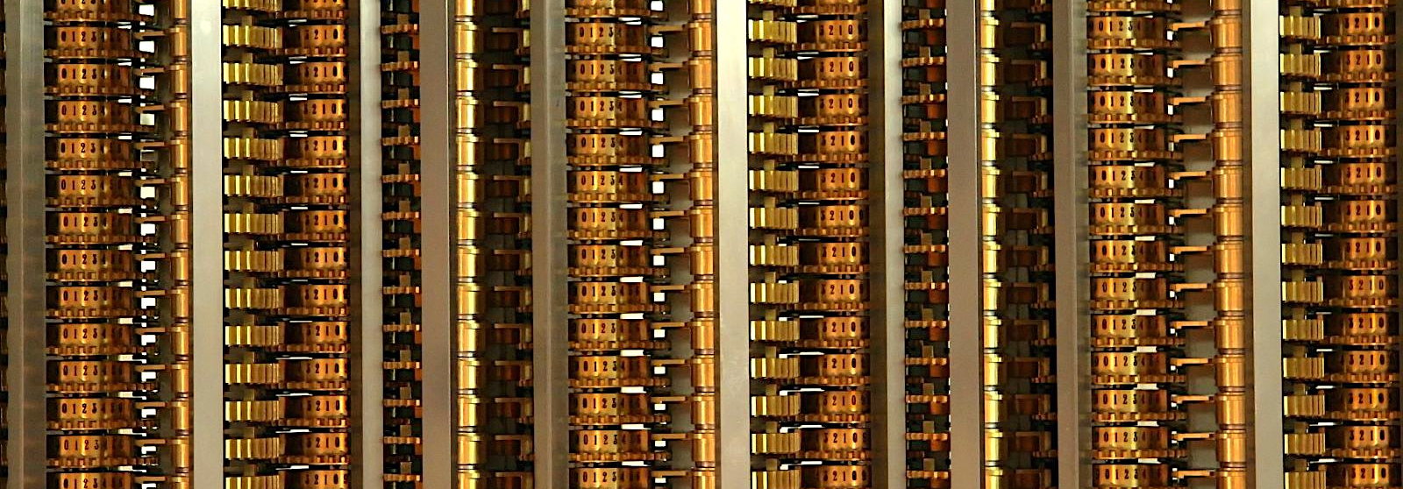
What is Machine Learning?
Notes:
Math at scale, transistors, all that. Lost of examples — just like us.

Slide 15
Gather
Data
Build a Model
Make Predictions

Slide 16
Gather
Data
Build a Model
Make Predictions
Target
Features

Slide 17
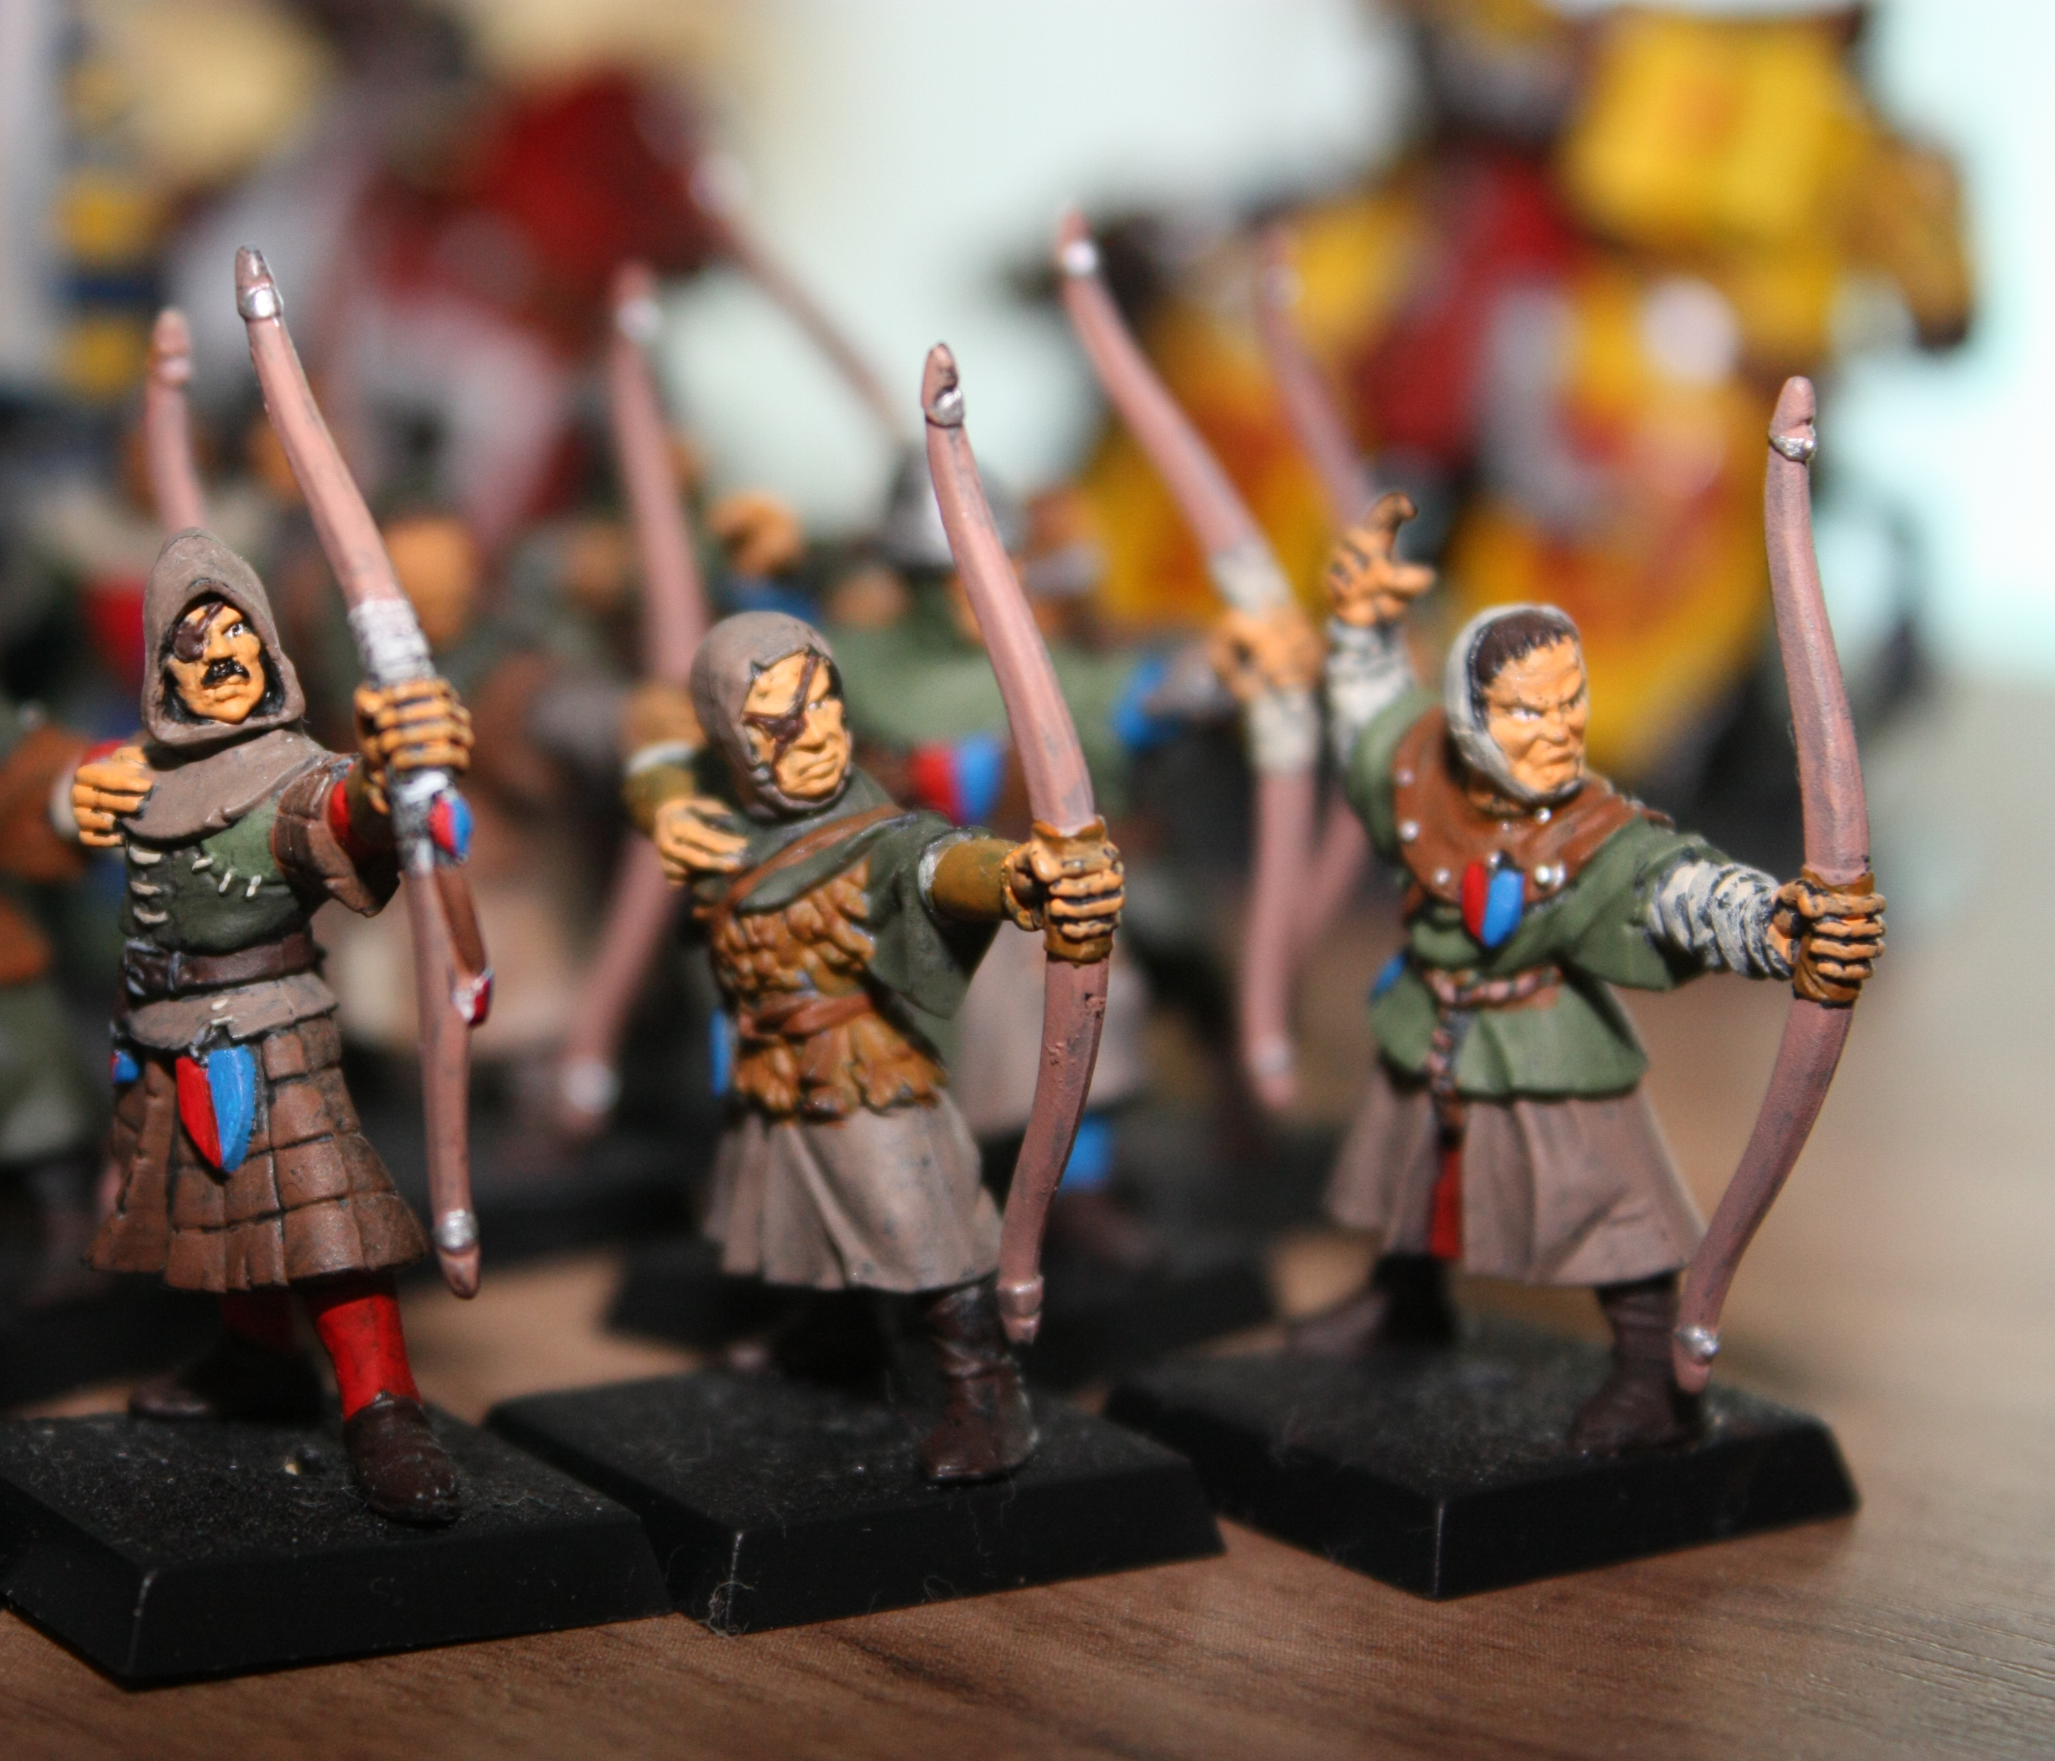
Target & Features
Target
The thing we want to predict
Features
Things that affect the thing we want to predict
Notes:
Evangelist, intro thyself.

Slide 18
Gather
Data
Build a Model
Make Predictions
Algorithm
Train/Test

Slide 19
Algorithms
◦ ARIMA
◦ Various combinations of
◦ AutoRegressive component with p parameters
◦ Differencing component with d parameters
◦ Moving Average component with q parameters
◦ with external regressors
◦ Exponential Smoothing
◦ Simple
◦ Double
◦ Triple
◦ with Box-Cox Transformation
◦ Autoregressive Neural Network
◦ with or without external regressors
◦ Multiple Linear Regression
◦ with or without external regressors
◦ Spline
◦ Seasonal and Trend Decomposition using Loess
◦ with ARIMA
◦ with or without external regressors
◦ with Exponential Smoothing
◦ Bayesian Time Series Regression
◦ with or without external regressors
◦ Additive Model
◦ Home-grown Nexosis Algorithms
◦ Least Squares
◦ Linear
◦ Polynomial
◦ Elastic Net
◦ Lasso
◦ Ridge
◦ Support Vector Regression
◦ Linear Kernel
◦ Polynomial Kernel
◦ Radial Basis Function kernel
◦ Sigmoid Kernel
◦ Multi-Layer Perceptron (Neural Network)
◦ with 1, 2, or 3 hidden layers
◦ Rectified Linear Unit Function
◦ Hyperbolic Tan Function
◦ Sigmoid Function
◦ Random Forest
◦ K-Nearest Neighbor
◦ Logistic Regression
◦ Naive Bayes
Notes:
Evangelist, intro thyself.

Slide 20

Train & Test
484 | 555 | 318 | 745 | 275 | 332 | 807 | 734 | 211 | 24 | 892
256 | 931 | 910 | 13 | 307 | 343 | 974 | 533 | 653 | 751 | 680
614 | 221 | 955 | 368 | 105 | 264 | 970 | 402 | 246 | 542 | 972
427 | 189 | 985 | 959 | 505 | 91 | 402 | 377 | 366 | 493 | 578
93 | 574 | 86 | 332 | 934 | 687 | 648 | 983 | 949 | 507 | 948
364 | 735 | 103 | 904 | 227 | 672 | 152 | 792 | 113 | 643 | 889
268 | 887 | 200 | 123 | 112 | 885 | 302 | 941 | 696 | 723 | 3
276 | 955 | 130 | 18 | 167 | 539 | 132 | 0 | 522 | 276 | 279
194 | 486 | 521 | 231 | 414 | 393 | 886 | 515 | 186 | 118 | 50
461 | 831 | 973 | 452 | 434 | 719 | 8 | 131 | 259 | 396 | 231
176 | 833 | 183 | 872 | 426 | 678 | 671 | 409 | 890 | 841 | 785
641 | 384 | 128 | 761 | 799 | 31 | 491 | 453 | 558 | 304 | 806

Slide 21
Train & Test
261 | 516 | 896 | 588 | 155 | 921 | 386 | 411 | 730 | 907 | 11
904 | 568 | 580 | 549 | 396 | 502 | 699 | 866 | 391 | 888 | 351
146 | 496 | 120 | 427 | 684 | 381 | 10 | 53 | 988 | 639 | 736
773 | 540 | 226 | 452 | 166 | 355 | 870 | 110 | 190 | 442 | 331
759 | 362 | 824 | 610 | 987 | 198 | 856 | 863 | 369 | 887 | 183
884 | 274 | 722 | 741 | 419 | 343 | 292 | 661 | 545 | 166 | 694
367 | 468 | 774 | 991 | 650 | 587 | 263 | 893 | 949 | 519 | 667
872 | 649 | 662 | 401 | 461 | 589 | 581 | 679 | 148 | 725 | 117
161 | 74 | 12 | 947 | 524 | 261 | 541 | 542 | 495 | 682 | 854
60 | 868 | 886 | 143 | 955 | 297 | 509 | 116 | 333 | 351 | 30
817 | 180 | 639 | 216 | 201 | 759 | 207 | 139 | 25 | 754 | 828
737 | 631 | 904 | 35 | 82 | 6 | 500 | 756 | 524 | 696 | 386

Slide 22
Gather
Data
Build a Model
Make Predictions
Algorithm
Train/Test

Slide 23
Gather
Data
Build a Model
Make Predictions
Provide Features
Get Target

Slide 24
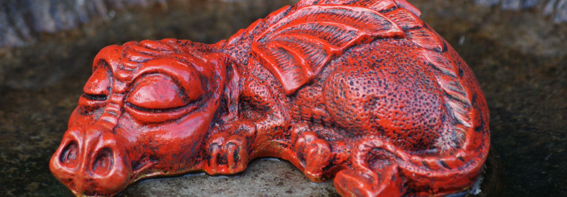
Regression
Determine the value of a dragon’s hoard in gold pieces based on the age, color, and hit points of that dragon.

Slide 25
About Dragons
Age
Color
Hit Points
Hoard Value
Wyrmling
Young
Adult
Ancient
Black
Blue
Green
Red
White
Brass
Bronze
Copper
Gold
Silver
How much damage the dragon can take until defeated
Total value of all the dragon’s treasure in gold pieces

Slide 26
The Data
Age | Color | Hit Points | Hoard Value
Young | Gold | 178 | 3,419.31
Ancient | Blue | 481 | 105,630.42
Ancient | Green | 385 | 107,355.23
Wyrmling | Green | 38 | 233.15
Adult | Red | 256 | 152,685.62
Adult | Brass | 172 | 4,490.94
Young | Silver | 168 | 2,786.95
Wyrmling | Copper | 22 | 155.11
Young | Black | 127 | 5,345.34
Adult | White | 200 | 3,789.23
Wyrmling | Bronze | 32 | 556.12
Ancient | Bronze | 444 | 123,891.74
Adult | White | 223 | 10,345.45

Slide 27
Asking the Question
Age | Color | Hit Points | Hoard Value
Ancient | Gold | 527 | ?
Age | Color | Hit Points | Hoard Value
Ancient | Gold | ? | 129,459.14

Slide 28
Can I Ask This?
Age | Color | Hit Points | Hoard Value
Ancient | ? | 527 | 129,459.14
Age | Color | Hit Points | Hoard Value
? | Gold | 527 | 129,459.14

Slide 29
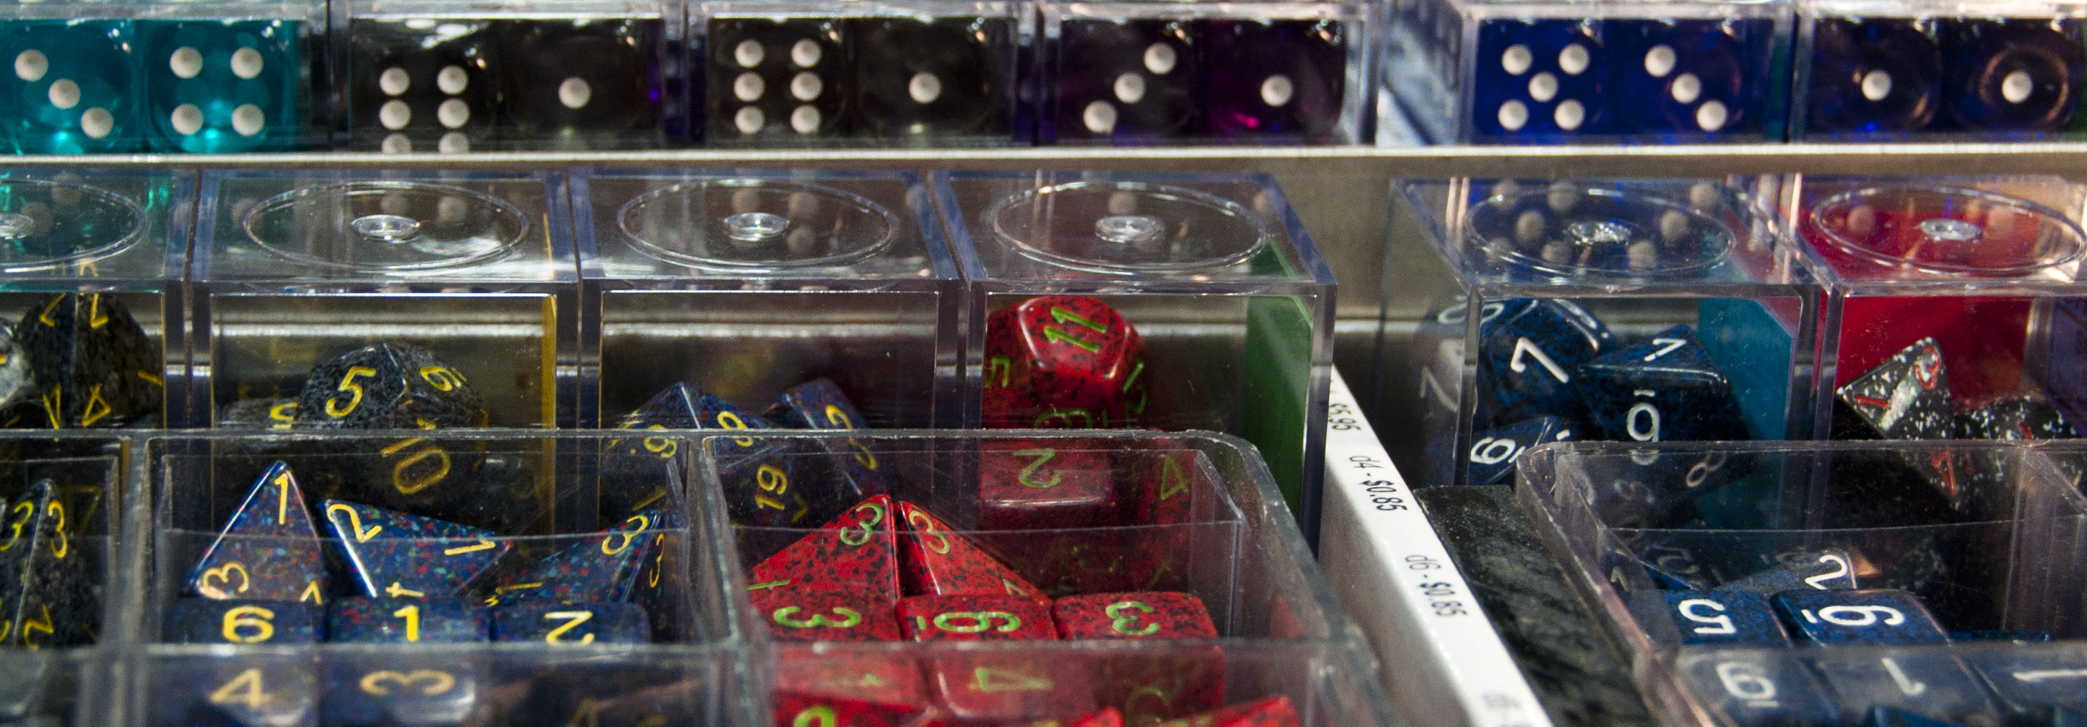
Classification
Based on the six key abilities and race of a character, determine what class they should play.

Slide 30
About Characters
Abilities
Race
Class
Strength
Dexterity
Constitution
Intelligence
Wisdom
Charisma
Elf
Dwarf
Halfling
Human
Gnome
Half-Elf
Half-Orc
Tiefling
Barbarian
Bard
Cleric
Druid
Fighter
Monk
Paladin
Ranger
Rogue
Sorcerer
Warlock
Wizard
Dragonborn

Slide 31
The Data
Str | Dex | Con | Int | Wis | Cha | Race | Class
14 | 13 | 15 | 11 | 9 | 15 | Half-Orc | Barbarian
8 | 12 | 15 | 13 | 11 | 12 | Half-Elf | Rogue
12 | 10 | 15 | 16 | 5 | 10 | Elf | Wizard
17 | 17 | 17 | 10 | 7 | 18 | Dwarf | Fighter
15 | 15 | 14 | 11 | 11 | 13 | Human | Fighter
13 | 8 | 14 | 5 | 12 | 17 | Halfing | Bard
18 | 16 | 15 | 13 | 9 | 15 | Halfling | Rogue
10 | 10 | 15 | 12 | 15 | 16 | Tiefling | Warlock
18 | 11 | 10 | 12 | 12 | 11 | Dwarf | Fighter
16 | 5 | 9 | 8 | 16 | 16 | Human | Paladin
16 | 14 | 11 | 13 | 13 | 15 | Dragonborn | Fighter
5 | 9 | 14 | 9 | 11 | 13 | Human | Bard
10 | 12 | 7 | 15 | 15 | 10 | Gnome | Cleric

Slide 32
Asking the Question
Str | Dex | Con | Int | Wis | Cha | Race | Class
14 | 13 | 15 | 11 | 9 | 15 | Half-Orc | ?
Barbarian | 0.97184
Bard | 0.83836
Cleric | 0.81324
Druid | 0.76682
Fighter | 0.76646
Monk | 0.64012
Paladin | 0.5957
Ranger | 0.5273
Rogue | 0.44096
Sorcerer | 0.27116
Warlock | 0.18702
Wizard | 0.07035

Slide 33
Asking the Question
Str | Dex | Con | Int | Wis | Cha | Race | Class
14 | 13 | 15 | 11 | 9 | 15 | ? | Cleric
Dwarf | 0.97184
Elf | 0.83836
Halfling | 0.81324
Human | 0.76682
Dragonborn | 0.76646
Gnome | 0.64012
Half-Elf | 0.27116
Half-Orc | 0.18702
Tiefling | 0.07035

Slide 34
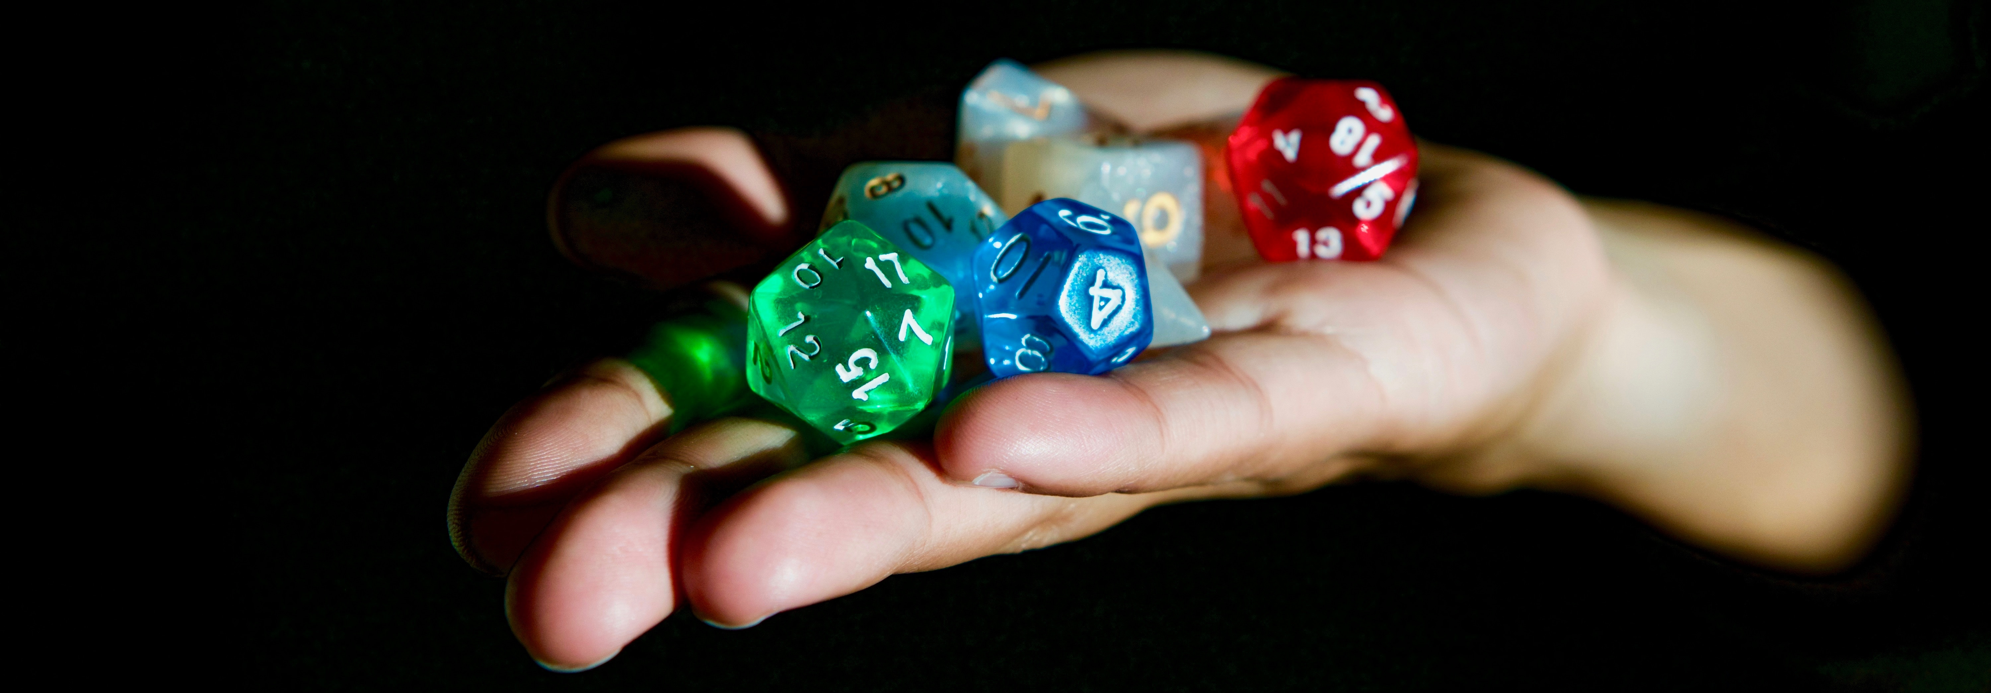
Forecasting
Predict the number of encounters that will be completed per weekly session for future weeks based on which players will be present and how long the session will last.

Slide 35
About Gaming Sessions
Date
Player’s
Length
Encounters
When the session occurred
The players who attended the game for that particular session
Time spent playing during that particular game session
Number of completed combats for the session

Slide 36
Training Data
Date | Alice | Bob | Chuck | Eve | Length | Encounters
11/13/2016 | Yes | Yes | Yes | Yes | 4.00 | 4
11/20/2016 | Yes | No | Yes | Yes | 4.50 | 4
11/27/2016 | Yes | Yes | Yes | Yes | 3.25 | 3
12/4/2016 | Yes | Yes | Yes | Yes | 5.50 | 6
12/11/2016 | Yes | Yes | Yes | No | 12.00 | 8
12/18/2016 | Yes | No | No | Yes | 4.00 | 7
12/25/2016 | No | No | No | No | 0.00 | 0
1/1/2017 | No | No | Yes | Yes | 4.50 | 3
1/8/2017 | Yes | Yes | Yes | Yes | 7.00 | 5
1/15/2017 | Yes | Yes | Yes | Yes | 6.25 | 7
1/22/2017 | Yes | Yes | No | Yes | 6.00 | 8
1/29/2017 | Yes | Yes | Yes | No | 4.00 | 4
2/5/2017 | Yes | Yes | Yes | Yes | 3.75 | 3

Slide 37
Asking the Question
Date | Alice | Bob | Chuck | Eve | Length | Encounters
2/12/2017 | Yes | Yes | Yes | Yes | 4.00 | ?
2/19/2017 | Yes | Yes | Yes | Yes | 4.00 | ?
2/26/2017 | Yes | Yes | Yes | No | 6.00 | ?
Date | Alice | Bob | Chuck | Eve | Length | Encounters
2/12/2017 | Yes | Yes | Yes | Yes | ? | 4
2/19/2017 | Yes | Yes | Yes | Yes | ? | 5
2/26/2017 | Yes | Yes | Yes | No | ? | 4

Slide 38
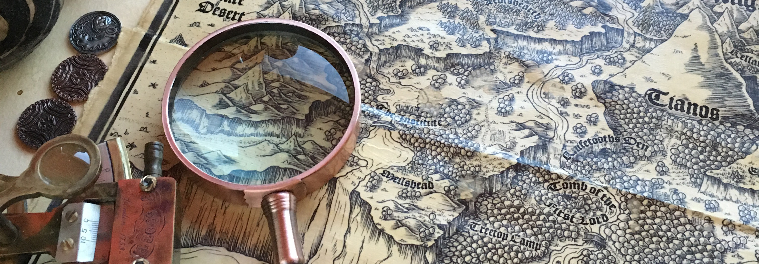
Impact Analysis
Measure the impact of updating your campaign from Pathfinder to 5th Edition.

Slide 39
Training Data
Date | Alice | Bob | Chuck | Eve | Length | Encounters
11/13/2016 | Yes | Yes | Yes | Yes | 4.00 | 4
11/20/2016 | Yes | No | Yes | Yes | 4.50 | 4
11/27/2016 | Yes | Yes | Yes | Yes | 3.25 | 3
12/4/2016 | Yes | Yes | Yes | Yes | 5.50 | 6
12/11/2016 | Yes | Yes | Yes | No | 12.00 | 8
12/18/2016 | Yes | No | No | Yes | 4.00 | 7
12/25/2016 | No | No | No | No | 0.00 | 0
1/1/2017 | No | No | Yes | Yes | 4.50 | 3
1/8/2017 | Yes | Yes | Yes | Yes | 7.00 | 5
1/15/2017 | Yes | Yes | Yes | Yes | 6.25 | 7
1/22/2017 | Yes | Yes | No | Yes | 6.00 | 8
1/29/2017 | Yes | Yes | Yes | No | 4.00 | 4
2/5/2017 | Yes | Yes | Yes | Yes | 3.75 | 3

Slide 40
Asking the Question
Date | Alice | Bob | Chuck | Eve | Length | Encounters
1/1/2017 | No | No | Yes | Yes | 4.50 | 3
1/8/2017 | Yes | Yes | Yes | Yes | 7.00 | 5
1/15/2017 | Yes | Yes | Yes | Yes | 6.25 | 7
1/22/2017 | Yes | Yes | No | Yes | 6.00 | 8
1/29/2017 | Yes | Yes | Yes | No | 4.00 | 4
2/5/2017 | Yes | Yes | Yes | Yes | 3.75 | 3
Date | Alice | Bob | Chuck | Eve | Length | Encounters
1/1/2017 | No | No | Yes | Yes | 4.50 | ?
1/8/2017 | Yes | Yes | Yes | Yes | 7.00 | ?
1/15/2017 | Yes | Yes | Yes | Yes | 6.25 | ?
1/22/2017 | Yes | Yes | No | Yes | 6.00 | ?
1/29/2017 | Yes | Yes | Yes | No | 4.00 | ?
2/5/2017 | Yes | Yes | Yes | Yes | 3.75 | ?

Slide 41
Asking the Question
Date | Actual Encoutners | Predicted Encounters | Change
1/1/2017 | 3 | 5.0346 | 2.0346
1/8/2017 | 5 | 8.391 | 3.391
1/15/2017 | 7 | 11.7474 | 4.7474
1/22/2017 | 8 | 13.4256 | 5.4256
1/29/2017 | 4 | 6.7128 | 2.7128
2/5/2017 | 3 | 5.0346 | 2.0346

Slide 42
Who is this Guy?
Guy Royse
Developer Evangelist
Nexosis
guy@nexosis.com
@guyroyse

Slide 43
Credits
Images
https://www.flickr.com/photos/t17emma/5909350021
https://www.flickr.com/photos/rueink/35095791331
https://www.flickr.com/photos/rueink/37125691160
https://www.flickr.com/photos/fauxlaroid/5988373053
https://www.flickr.com/photos/kimonomania/602858091
https://www.flickr.com/photos/wonderferret/174314534
https://www.flickr.com/photos/herval/4100847043

Slide 44


